Slide 1
3D Chromatin Architecture
GENOME 541
Prof. William Stafford Noble
University of Washington

Slide 2
Outline
3C-based assays of chromatin conformation
3D structure inference
Uses for 3D structure and Hi-C

Slide 3
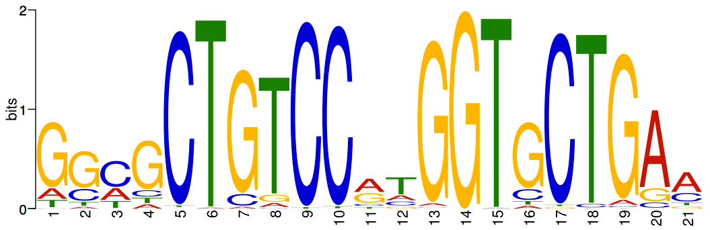
Local regulatory elements do not fully explain gene regulation
x
repressive region
active region

Slide 4
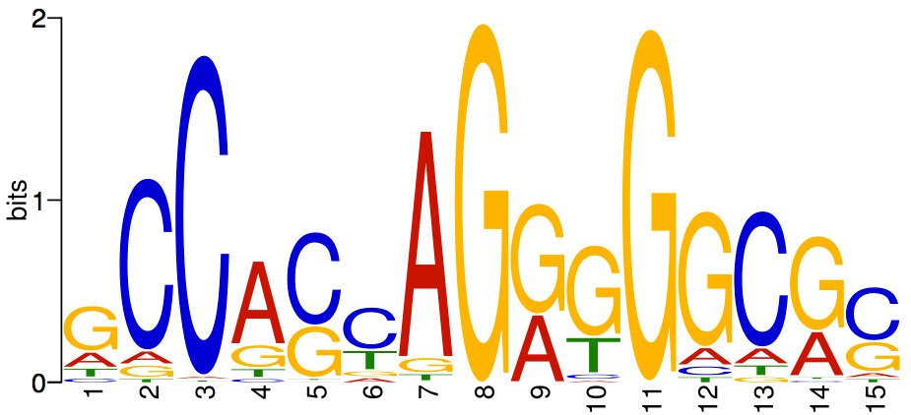
DNA 3D structure influences gene expression
x
...
CCGACTG
CCGACTG
localizing element
active
compartment
repressive compartment
transcription
factory
...
enhancer
localizing element

Slide 5
DNA 3D structure influences gene expression
x
...
CCGACTG
CCGACTG
localizing element
active
compartment
repressive compartment
transcription
factory
...
enhancer
CCGACTG
CCGACTG
localizing element

Slide 6
3C-based assays
3C: Measures a single interaction.
4C: Measures interactions between a given locus (“bait”) and everything else.
Parallel 4C: Measures interactions with multiple baits.
ChIA-PET: Parallel 4C using a ChIP experiment as bait.
5C: Measures all interactions in a given region.
Hi-C: All interactions.
v

Slide 7
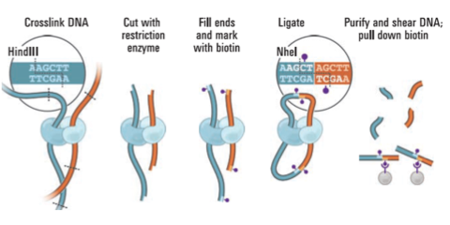
Hi-C measures proximal pairs of DNA loci through crosslinking and sequencing
Lieberman-Aiden et al. Science, 2009

Slide 8
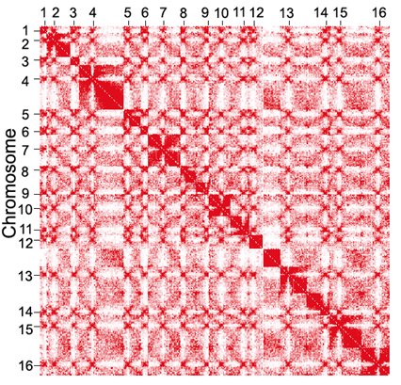
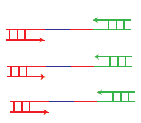
Output of Hi-C is a contact matrix
Chromosome
paired-end reads
Many contacts
Few contacts
C(i,j) = How many times
is locus i linked to locus j
by a paired-end read?
i
Chromosome
j
Notes:
Explain telomere pattern.
Say that every entry is an integer.

Slide 9
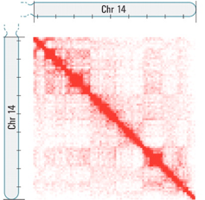

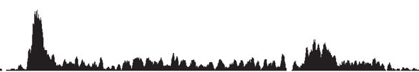
Hi-C requires much more sequencing than other genomics assays
Hi-C contact strength
1D genome assay
(DNase-seq, ChIP-seq, etc)
Many
Few
Requires O(n) reads
Requires O(n²) reads
Hi-C analysis is conducted at a coarse
resolution: typically 10kb-100kb

Slide 10
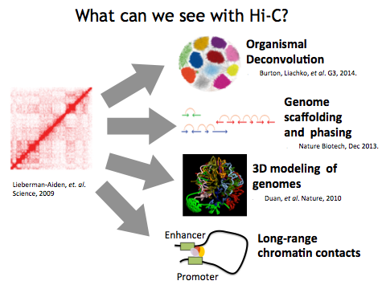
What can we see with Hi-C?

Slide 11
Outline
3C-based assays of chromatin conformation
3D structure inference
Uses for 3D structure and Hi-C

Slide 12
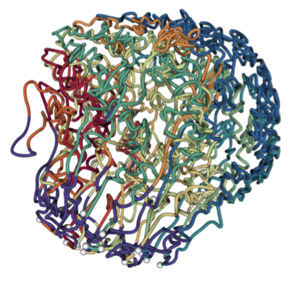
Problem: How can we infer the chromatin’s 3D structure from Hi-C data?
3D structure
inference
Pairwise contact counts
genome 3D structure
Lieberman-Aiden et al. Science, 2009
Duan et al. Nature 2010

Slide 13
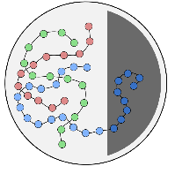
Beads-on-a-string model
Divide chromosomes into 10kb beads.
Infer 3D position of each bead.
How can we infer distances between beads from Hi-C data?

Slide 14
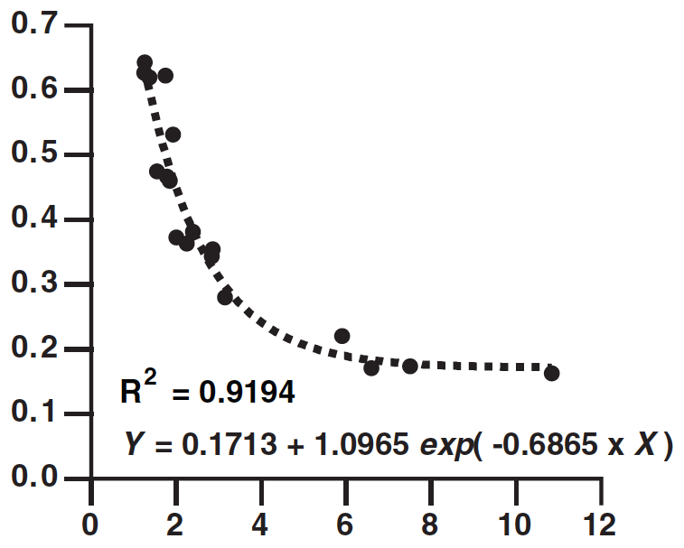
How does Hi-C contact count relate to 3D distance?
FISH distance (microns)
Hi-C contact counts (rescaled)
Tanizawa Nucleic Acids Res 2010
Notes:
Mention that FISH is microscopy.

Slide 15
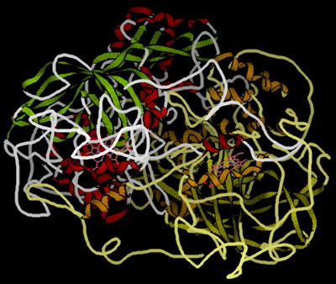
Polymers exhibit predictable self-looping behavior
Two loci close in genomic coordinates are likely to randomly be in contact.
chemguide.co.uk

Slide 16
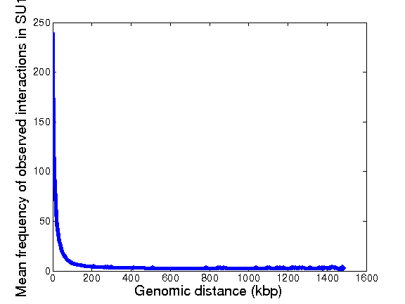
Convert contact counts to 3D distance
130bp of packed chromatin has length 1 nm (Bystricky PNAS 2004).
Mean contact count
0
3
6
9
12
Genomic distance (kbp)
Euclidean distance (microns)

Slide 17
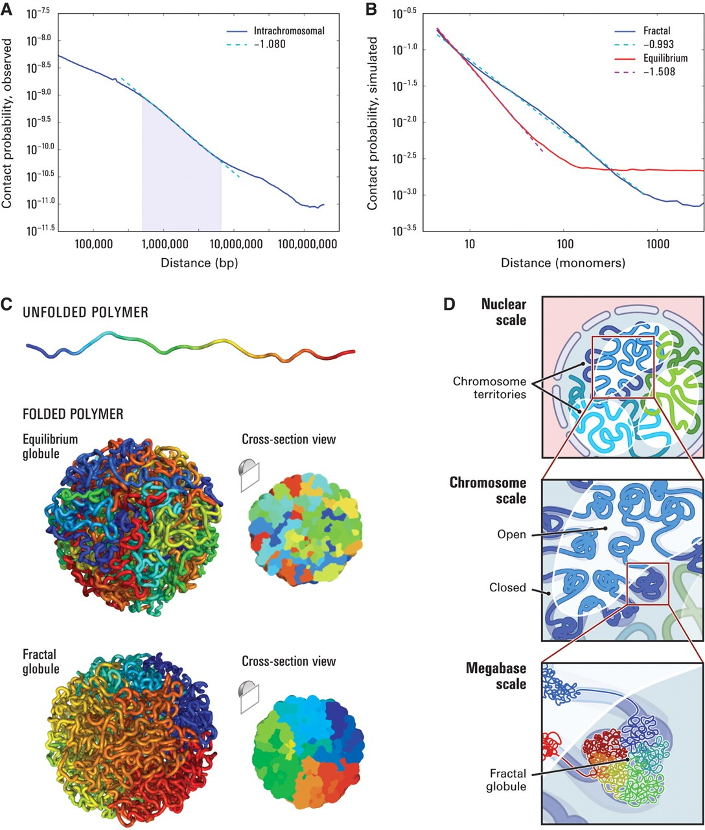
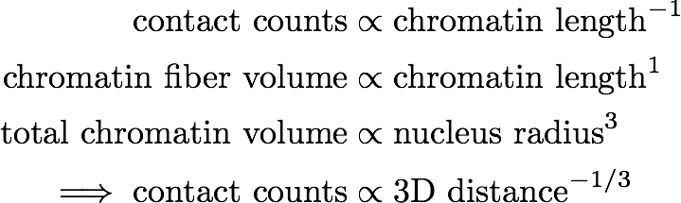
Polymer physics dictates relationship between contact counts and 3D distance
Power law relationship
Predicted by fractal globule simulation: 1.0
Observed: 1.08
Fractal globule model:

Slide 18
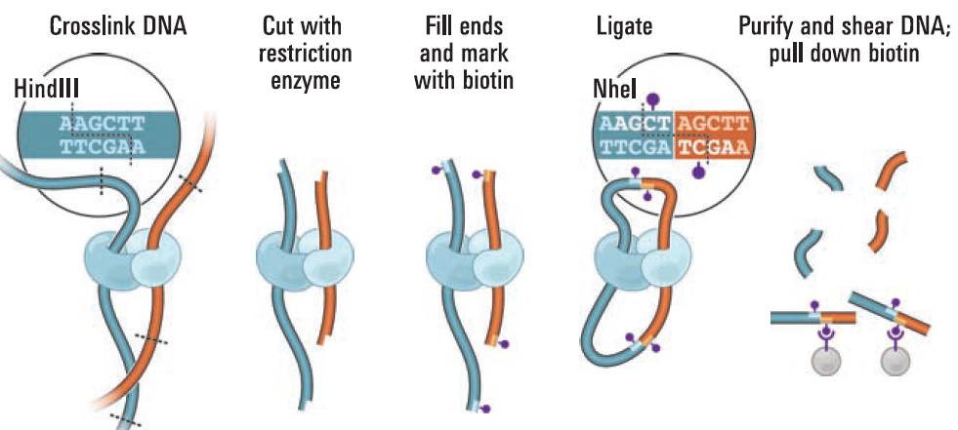
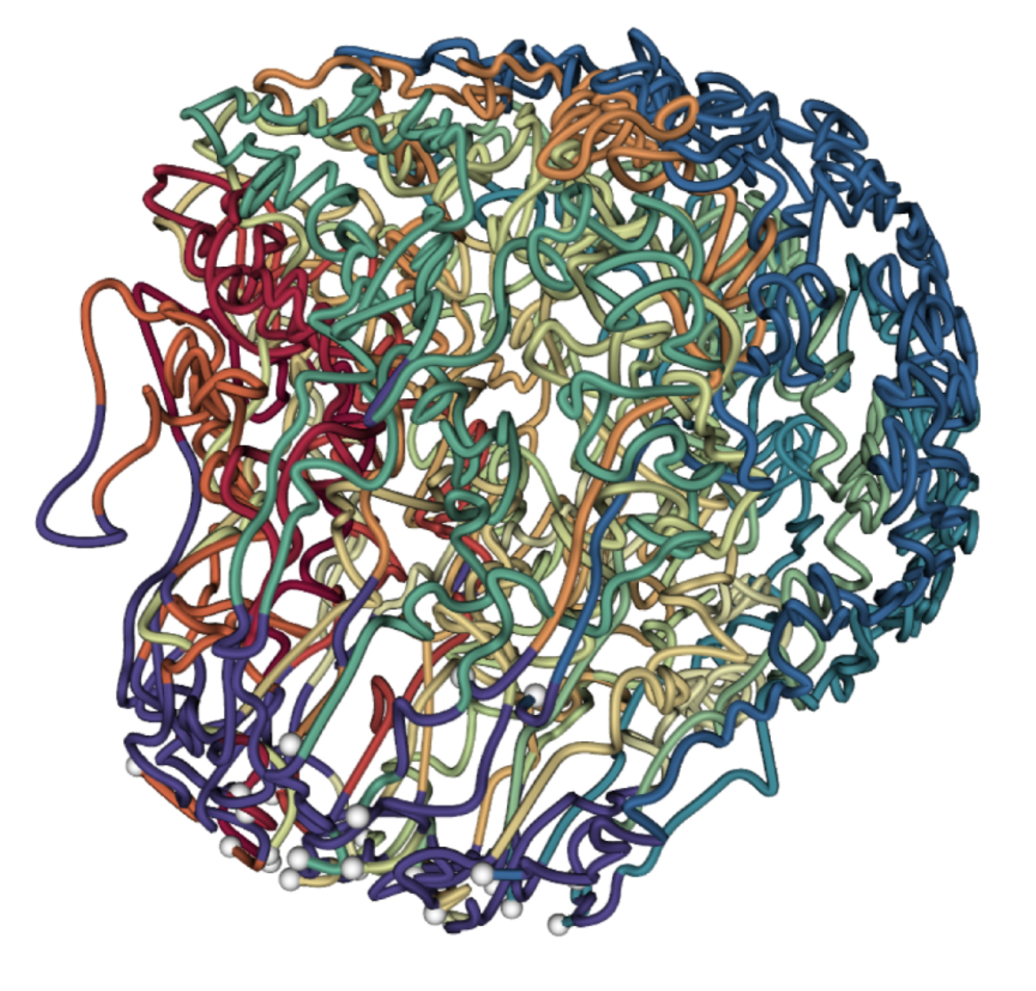
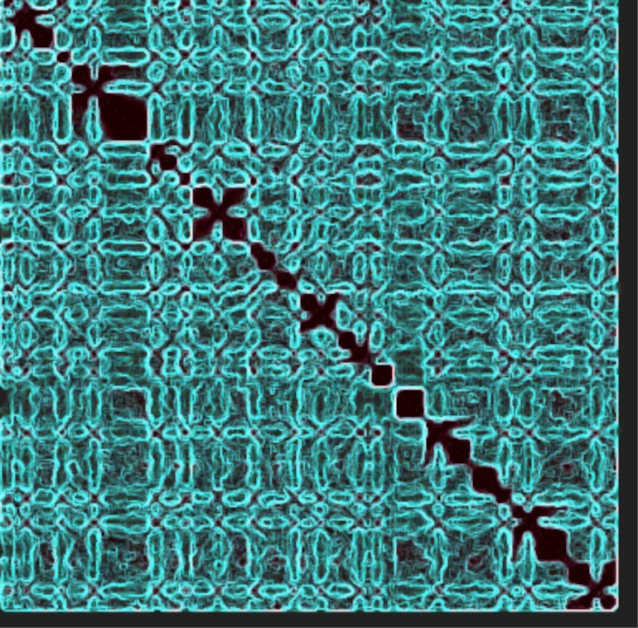
Can we infer 3D structure from Hi-C contacts?
Hi-C
?
Contact map
Distance matrix
3D structure

Slide 19
A simple distance matrix in 2D
 | A | B | C | D
A | 0 | 2 | 1.4 | 2.2
B | 2 | 0 | 1.4 | 2.2
C | 1.4 | 1.4 | 0 | 1
D | 2.2 | 2.2 | 1 | 0
B (0,2)
C (1,1)
D (2,1)
A (0,0)

Slide 20
With perfect data, the problem is easy.
 | A | B | C | D
A | 0 | 2 | 1.4 | 2.2
B | 2 | 0 | 1.4 | 2.2
C | 1.4 | 1.4 | 0 | 1
D | 2.2 | 2.2 | 1 | 0
C
A
B
2
Notes:
Mention that location of C is symmetric.

Slide 21
With perfect data, the problem is easy.
D
 | A | B | C | D
A | 0 | 2 | 1.4 | 2.2
B | 2 | 0 | 1.4 | 2.2
C | 1.4 | 1.4 | 0 | 1
D | 2.2 | 2.2 | 1 | 0
C
A
B

Slide 22
With perfect data, the problem is easy.
D
 | A | B | C | D
A | 0 | 2 | 1.4 | 2.2
B | 2 | 0 | 1.4 | 2.2
C | 1.4 | 1.4 | 0 | 1
D | 2.2 | 2.2 | 1 | 0
C
A
B

Slide 23
With perfect data, the problem is easy.
D
 | A | B | C | D
A | 0 | 2 | 1.4 | 2.2
B | 2 | 0 | 1.4 | 2.2
C | 1.4 | 1.4 | 0 | 1
D | 2.2 | 2.2 | 1 | 0
1.0
2.2
2.2
C
1.4
1.4
A
B
2

Slide 24
With noisy data, the problem is hard.
 | A | B | C | D
A | 0 | 2.1 | 1.3 | 2.4
B | 2.1 | 0 | 1.5 | 2.4
C | 1.3 | 1.5 | 0 | 1
D | 2.4 | 2.4 | 1 | 0
C
A
B
2.1

Slide 25
With noisy data, the problem is hard.
“Shit!”
 | A | B | C | D
A | 0 | 2.1 | 1.3 | 2.4
B | 2.1 | 0 | 1.5 | 2.4
C | 1.3 | 1.5 | 0 | 1
D | 2.4 | 2.4 | 1 | 0
C
1.3
1.5
A
B
2.1

Slide 26
Instead, place points randomly
 | A | B | C | D
A | 0 | 2.1 | 1.3 | 2.4
B | 2.1 | 0 | 1.5 | 2.4
C | 1.3 | 1.5 | 0 | 1
D | 2.4 | 2.4 | 1 | 0
B
A
D
C

Slide 27
Compute your own distance matrix
 | A | B | C | D
A | 0 | 2.1 | 1.3 | 2.4
B | 2.1 | 0 | 1.5 | 2.4
C | 1.3 | 1.5 | 0 | 1
D | 2.4 | 2.4 | 1 | 0
B
A
 | A | B | C | D
A | 0 | 1.8 | 0.9 | 2.5
B | 1.8 | 0 | 3.2 | 2.2
C | 0.9 | 3.2 | 0 | 1.7
D | 2.5 | 2.2 | 1.7 | 0
D
C

Slide 28
Subtract the two matrices
 | A | B | C | D
A | 0 | 2.1 | 1.3 | 2.4
B | 2.1 | 0 | 1.5 | 2.4
C | 1.3 | 1.5 | 0 | 1
D | 2.4 | 2.4 | 1 | 0
 | A | B | C | D
A | 0 | 0.3 | 0.4 | -0.1
B | 0.3 | 0 | -1.7 | 0.2
C | 0.4 | -1.7 | 0 | -0.7
D | -0.1 | 0.2 | -0.7 | 0
 | A | B | C | D
A | 0 | 1.8 | 0.9 | 2.5
B | 1.8 | 0 | 3.2 | 2.2
C | 0.9 | 3.2 | 0 | 1.7
D | 2.5 | 2.2 | 1.7 | 0

Slide 29
Square the values
 | A | B | C | D
A | 0 | 2.1 | 1.3 | 2.4
B | 2.1 | 0 | 1.5 | 2.4
C | 1.3 | 1.5 | 0 | 1
D | 2.4 | 2.4 | 1 | 0
 | A | B | C | D
A | 0 | 0.3 | 0.4 | -0.1
B | 0.3 | 0 | -1.7 | 0.2
C | 0.4 | -1.7 | 0 | -0.7
D | -0.1 | 0.2 | -0.7 | 0
 | A | B | C | D
A | 0 | 1.8 | 0.9 | 2.5
B | 1.8 | 0 | 3.2 | 2.2
C | 0.9 | 3.2 | 0 | 1.7
D | 2.5 | 2.2 | 1.7 | 0
 | A | B | C | D
A | 0 | 0.09 | 0.16 | 0.01
B | 0.09 | 0 | 2.89 | 0.02
C | 0.16 | 2.89 | 0 | 0.49
D | 0.01 | 0.16 | 0.49 | 0

Slide 30
The sum of the values is a measure of the quality of the current solution
 | A | B | C | D
A | 0 | 0.09 | 0.16 | 0.01
B | 0.09 | 0 | 2.89 | 0.02
C | 0.16 | 2.89 | 0 | 0.49
D | 0.01 | 0.16 | 0.49 | 0
= 7.32
Small value ➔ High quality

Slide 31
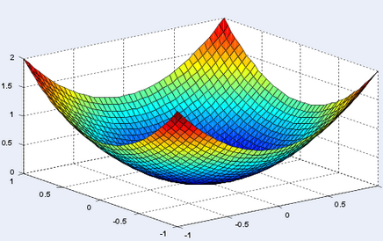
The set of all possible point placements defines a surface
7.32

Slide 32

Use calculus to compute the gradient
7.32

Slide 33
Move the points according to the gradient
 | A | B | C | D
A | 0 | 2.1 | 1.3 | 2.4
B | 2.1 | 0 | 1.5 | 2.4
C | 1.3 | 1.5 | 0 | 1
D | 2.4 | 2.4 | 1 | 0
B
A
D
Repeat until the gradient is zero.
C

Slide 34
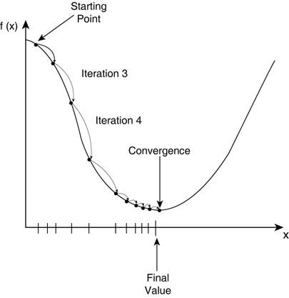

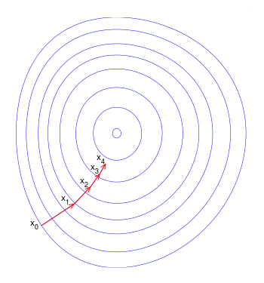
Learning rate determines the step size
Gradient descent update step:
t: “Learning rate”. Must be chosen.

Slide 35
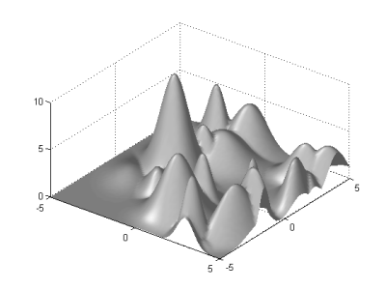
Q: What if the surface is complex?
7.32

Slide 36
The MDS objective is convex*
The class of convex functions (defined on the next slide) roughly corresponds to the set of efficiently optimizable continuous functions.
When presented with an objective function, the first step is usually to check if it is convex.
* But only when the data is Euclidean and noise-free.
36￼

Slide 37

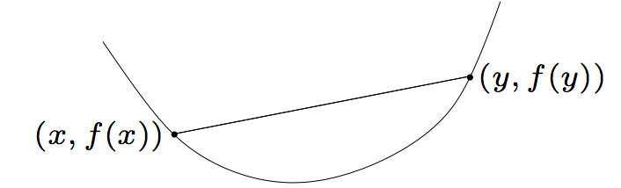
Convex functions
A function f(x) is convex if it satisfies the property:
Convex functions have no local minima.
37￼

Slide 38
Concave functions
A function f(x) is concave if -f(x) is convex.
Convex functions are usually efficiently minimizable.
Concave functions are usually efficiently maximizable.
(A function can be neither convex nor concave.)

Slide 39
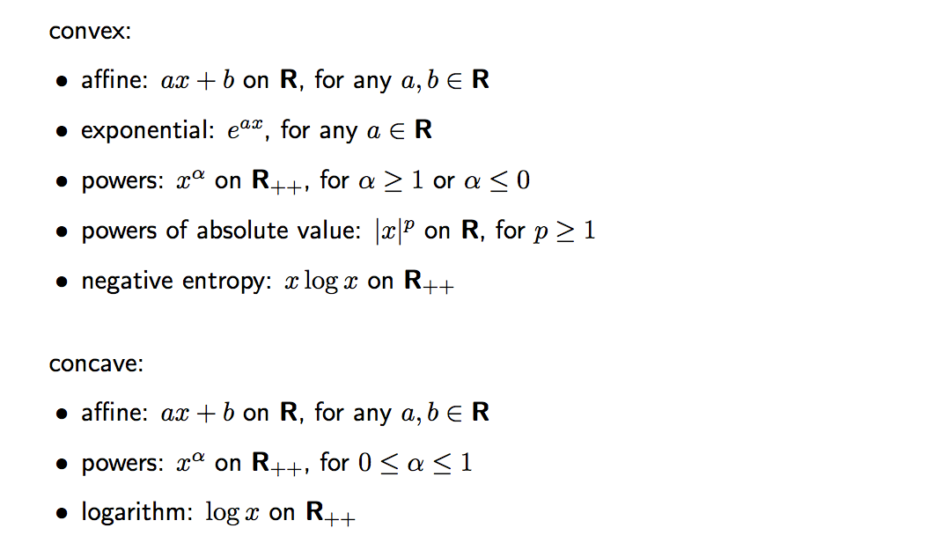
Examples on one variable
39￼
Stanford EE364a

Slide 40
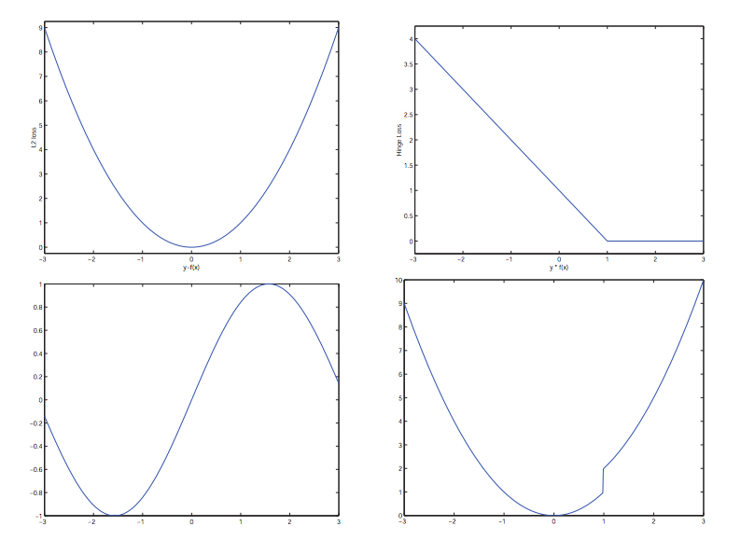
Examples on one variable
Convex:
Non-convex:
40￼
Duke stat376

Slide 41

Second derivative criterion for convexity
The function f(x) is convex if and only if
Stanford EE364a

Slide 42
Yes, we can we infer 3D structure from Hi-C contacts
Hi-C
Contact map
Distance matrix
3D structure

Slide 43
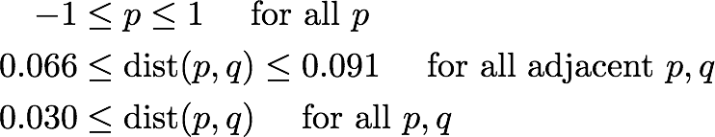
Additional properties of a 3D model
All beads must lie within in the nucleus (radius ~1μm):
Adjacent beads on a chromosome are within 66-91nm:
Volume exclusion: Non-adjacent beads must be at least 30nm apart:
(Other constraints relating to chromatin crossing, nucleolus, centromeres.)

Slide 44
Duan Nature 2010

Slide 45
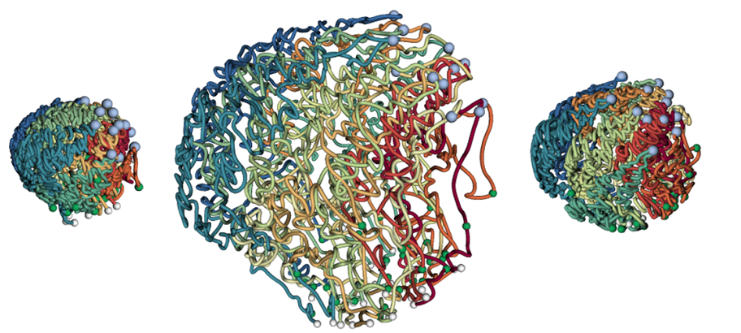
Ay Genome Res 2014
0 hours post infection
18 hours post infection
36 hours post infection

Slide 46
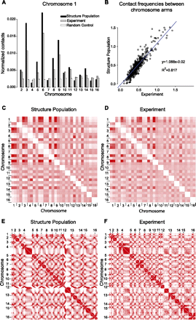
Physical tethering and volume exclusion determine much of 3D structure
Small set of constraints:
Volume exclusion
Centromeres lie at SPB
Telomeres lie at periphery
rRNA lies in nucleolus
Simulate structures
Real yeast cells
Hi-C
Simulate Hi-C reads
Correlation = 0.94
Contact matrix
Simulated contact matrix
Tjong et al. Genome Research, 2012

Slide 47
Other considerations in 3D modeling
Model the uncertainty in Hi-C read counts.
Assume only that read counts decrease with distance, not an explicit distance function.
Model an ensemble of structures.
Handle diploid genomes.

Slide 48
Outline
3C-based assays of chromatin conformation
3D structure inference
Uses for 3D structure and Hi-C

Slide 49
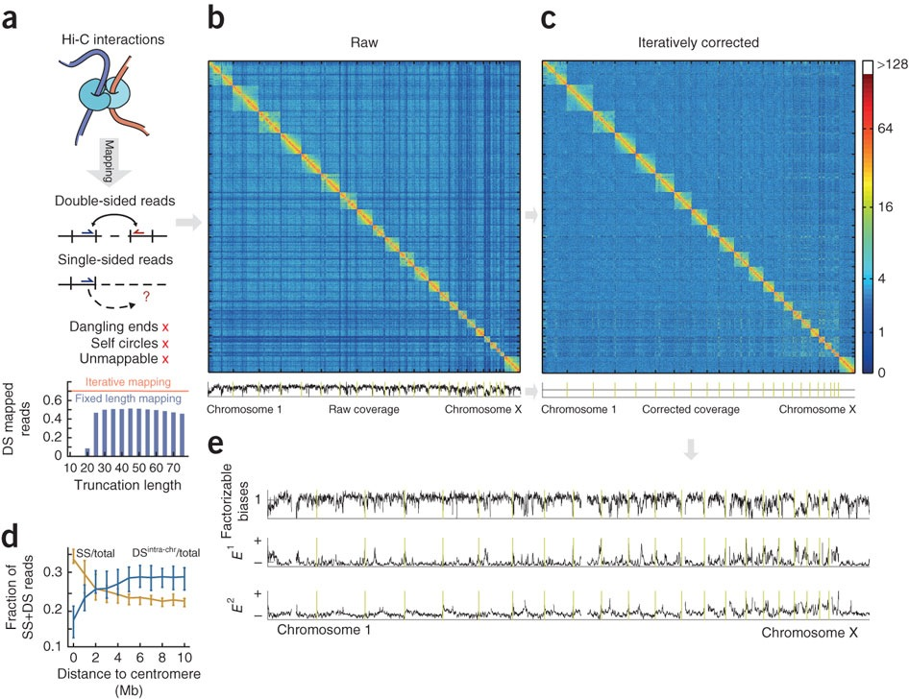
Removing factorizable effects controls for biases in Hi-C
Dark or light bands indicate biases caused by mappability, restriction site density and other effects
Raw data
Coverage
Imakaev et al, Nature Methods 2012

Slide 50
Removing factorizable effects controls for biases in Hi-C
Dark or light bands indicate biases caused by mappability, restriction site density and other effects
Raw data
Normalized data
Divide by
marginal
coverage
Coverage
Coverage
Imakaev et al, Nature Methods 2012

Slide 51
Controlling for 1D genomic distance allows statistical confidence estimation for Hi-C contacts
Hi-C contact counts are strongly inversely correlated with genomic distance
Ay et al, Genome Research 2014

Slide 52
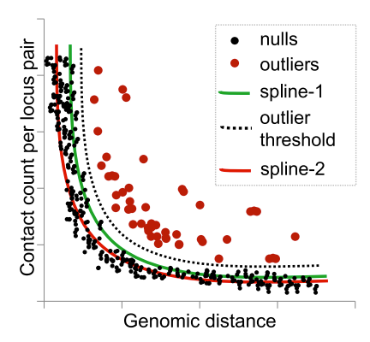
Controlling for 1D genomic distance allows statistical confidence estimation for Hi-C contacts
Hi-C contact counts are strongly inversely correlated with genomic distance
Pairs of positions with many more contacts than expected given their 1D distance are significant contacts
Ay et al, Genome Research 2014

Slide 53
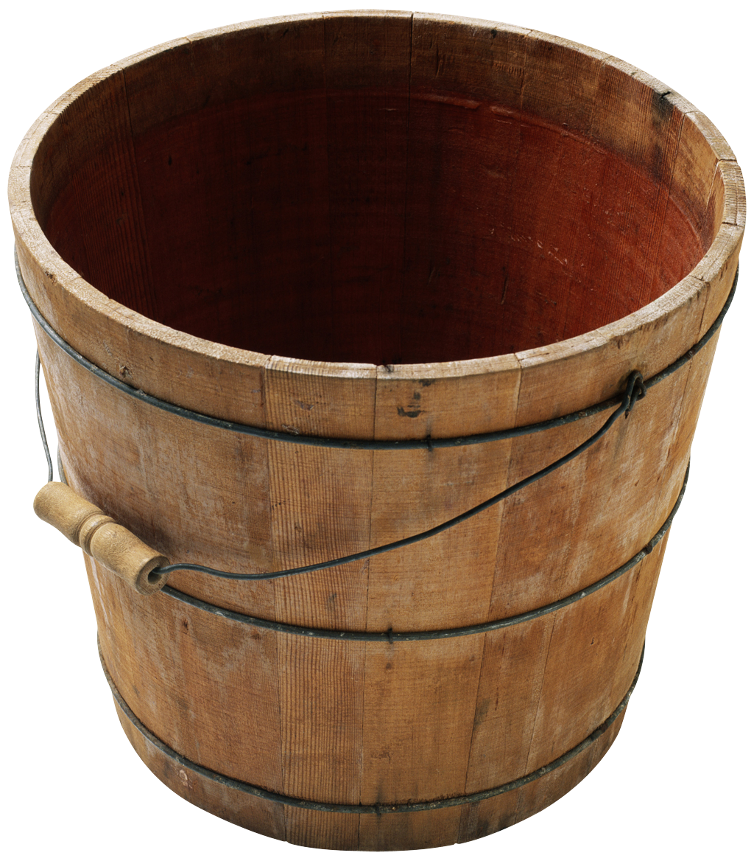
Binomial p-value calculation
1/ (Total number of locus pairs)
Observed contact count
Sum of contact counts for all locus pairs
Notes:
Add slide showing actual binomial calculation.

Slide 54
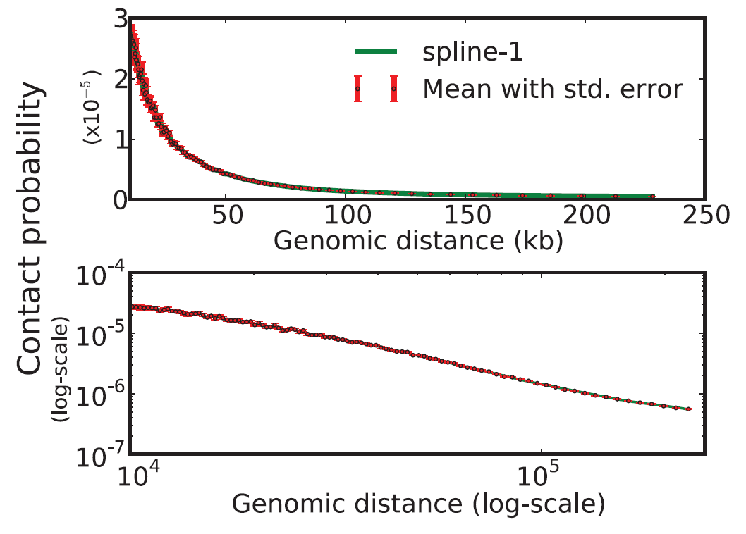
Notes:
INCLUDE POWER LAW FIT

Slide 55
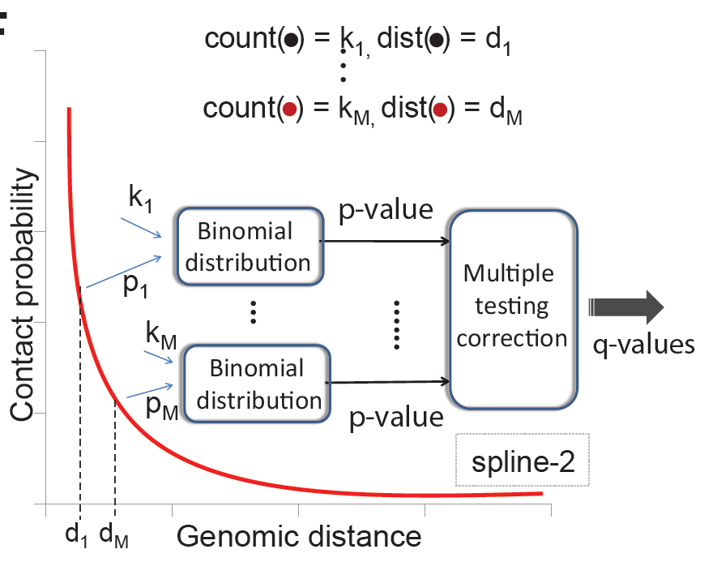
Spline fitting ➔ FDR control
FDR controlled list of contacts
m₁
m₂

Slide 56
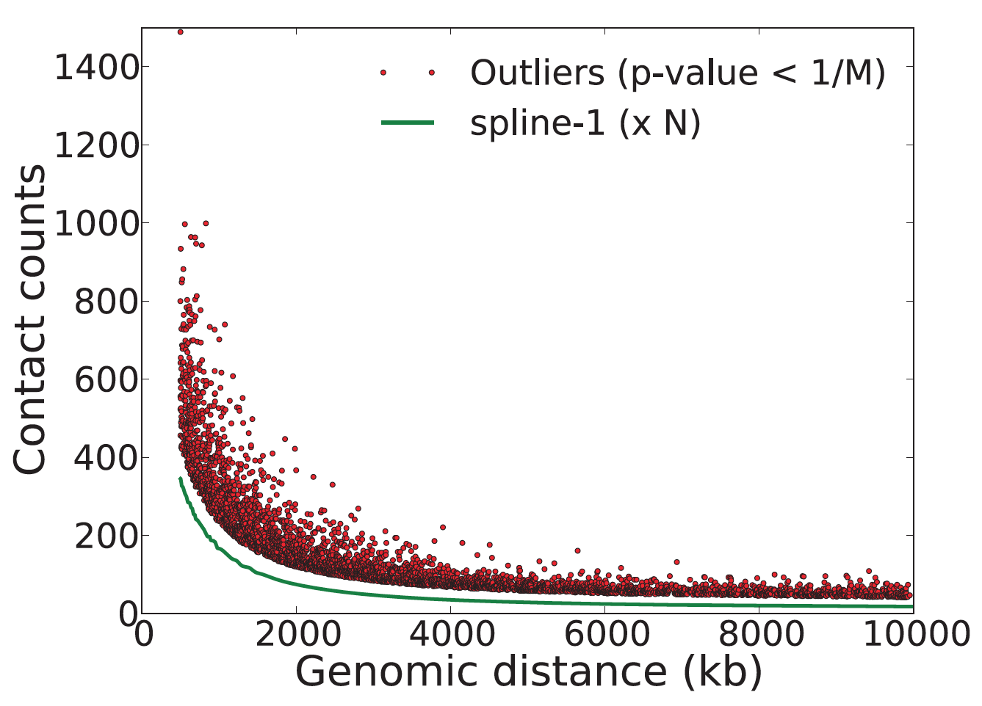
We expect on average one false positive in this set

Slide 57
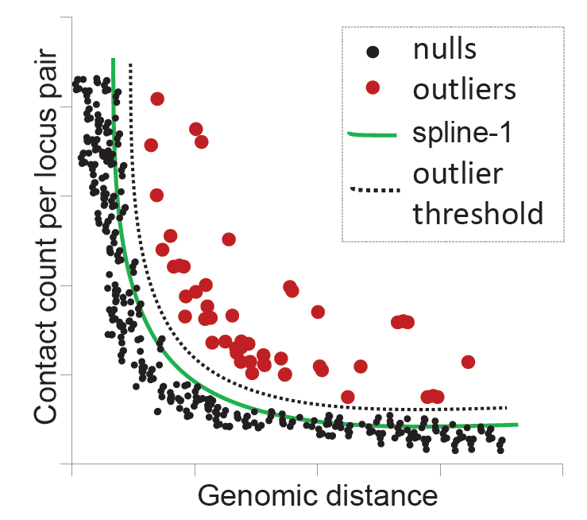

Slide 58
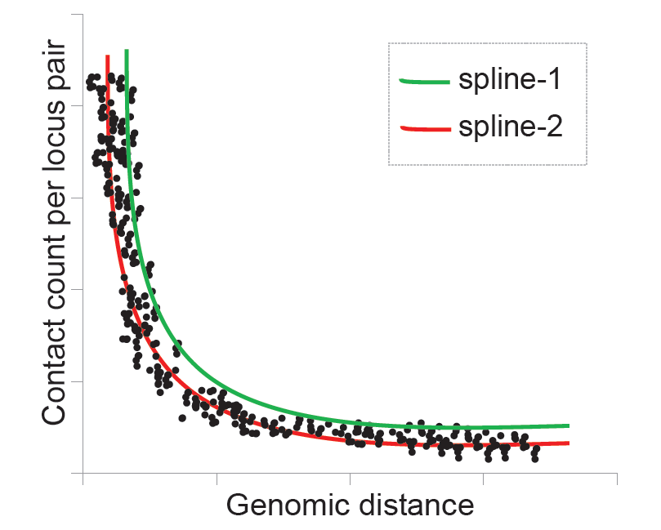

Slide 59
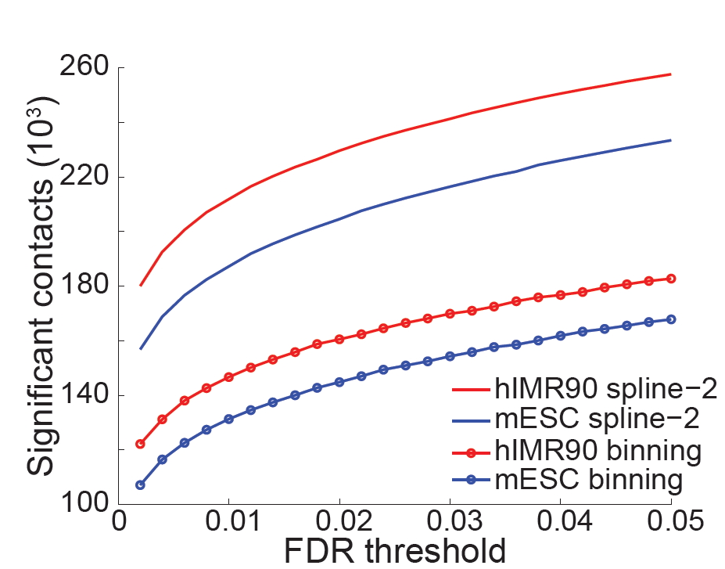
Increased statistical power

Slide 60
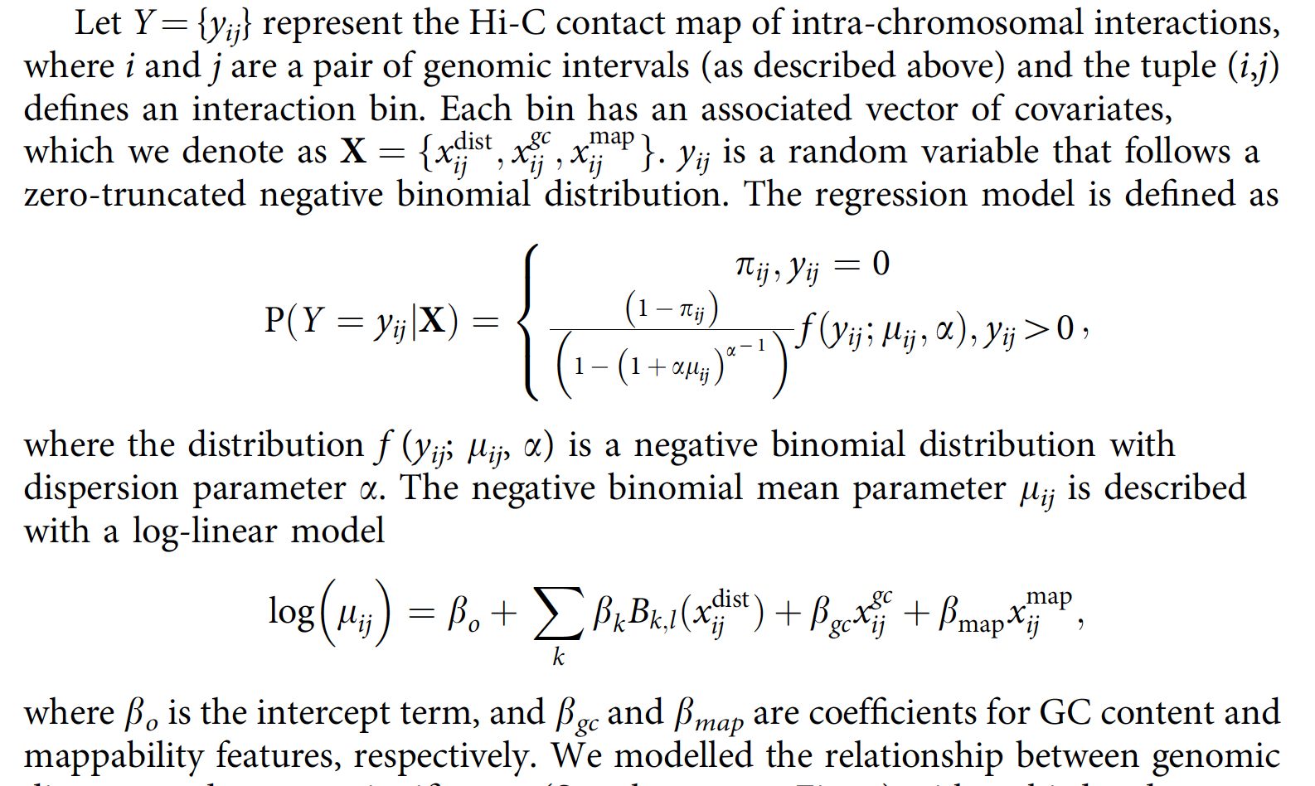
HiC-DC uses a zero inflated negative binomial and models GC content and mappability
Carty et al. Nature Comm 2017

Slide 61
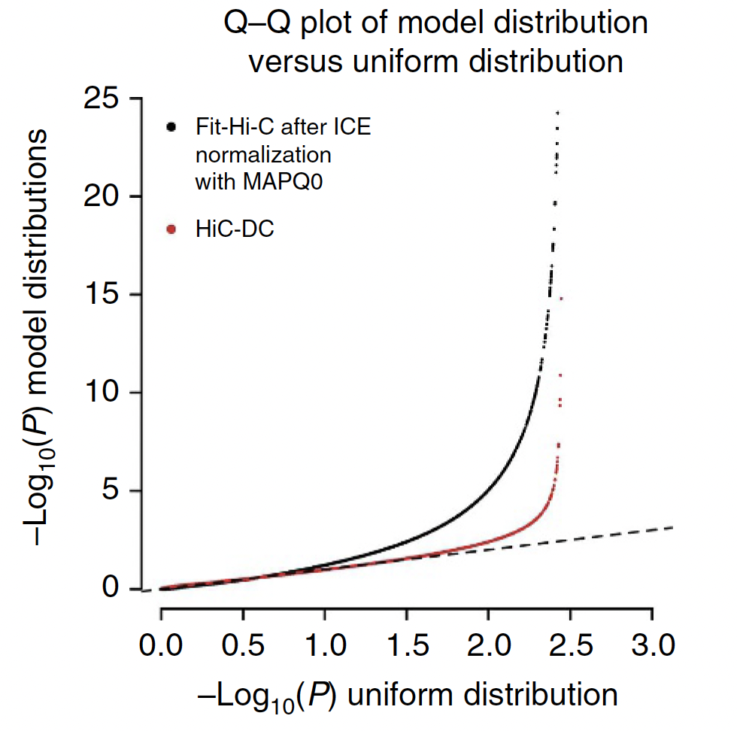
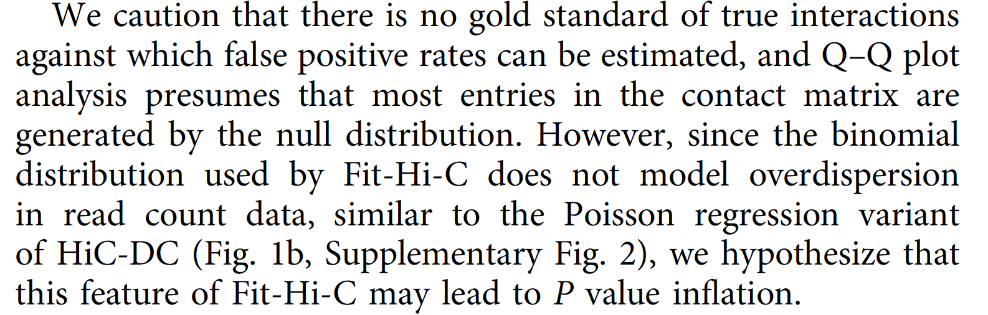
HiC-DC yields improved apparent statistical power

Slide 62
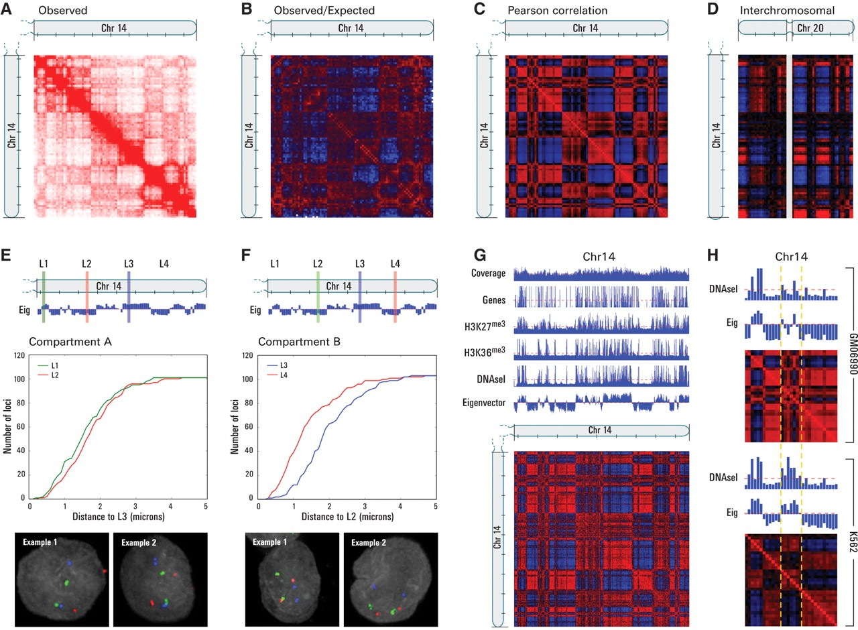
Hi-C data suggests a two-compartment structure
Pearson correlation
of contact counts
Plaid pattern suggests two-compartment model
Lieberman-Aiden et al, Science 2009

Slide 63
Hi-C data suggests a two-compartment structure
Pearson correlation
of contact counts
Plaid pattern suggests two-compartment model
A
B
A
B
A
Eigenvalue
decomposition
Lieberman-Aiden et al, Science 2009

Slide 64
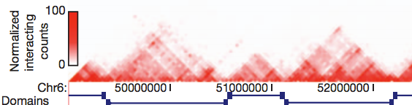
The genome exhibits self-interacting topologically associating domains (TADs)
Dixon et al, Nature 2012

Slide 65
TADs are identified using directionality index plus an HMM
Dixon et al, Nature 2012

Slide 66
Alternatively, TADs are identified using insulation score plus peak finding
Crane et al. Nature 2015

Slide 67
TADs are identified using insulation score plus peak finding
Crane et al. Nature 2015

Slide 68
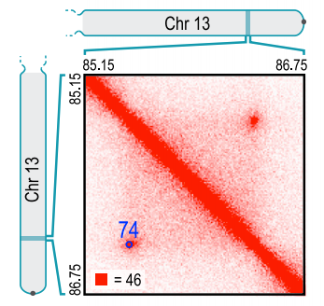
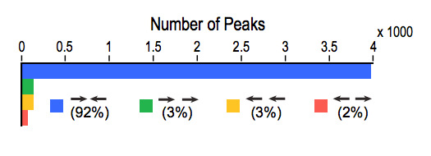
High-resolution Hi-C identifies chromatin loops marked by CTCF
A “contact” is a single pixel that is significantly enriched relative to a global background.
A “loop” shows significant enrichment relative to its local background.
90% bound by CTCF
CCACNAGGTGGCAG
CCACNAGGTGGCAG
Rao et al, Cell 2014

Slide 69
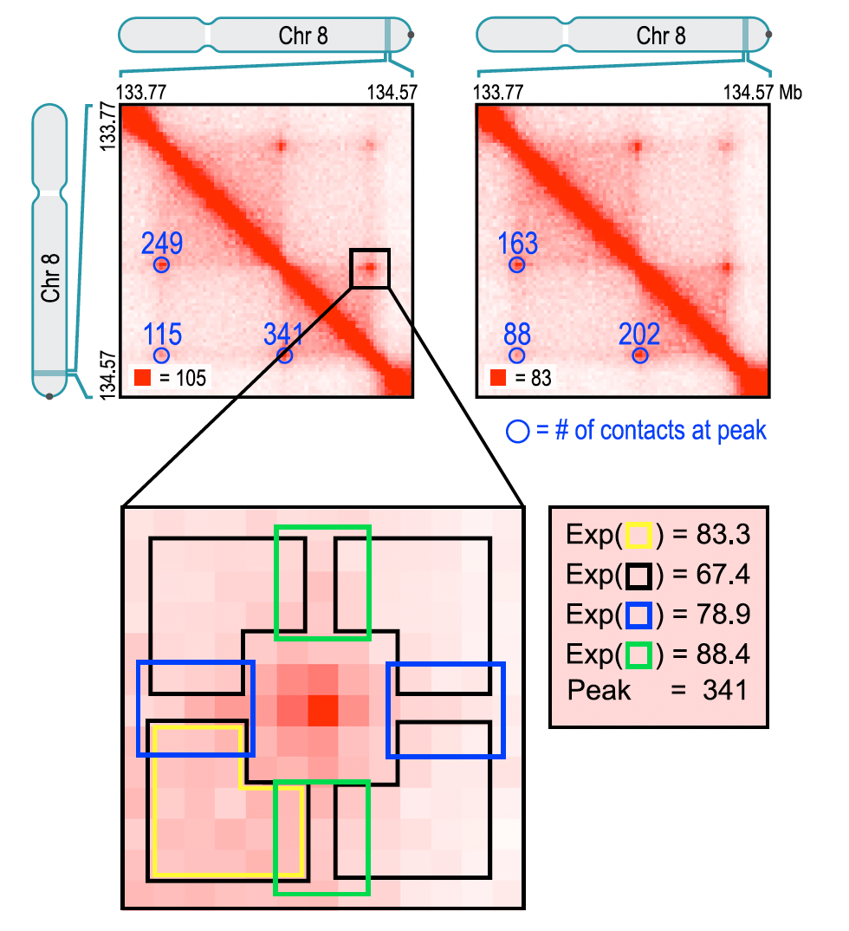
HiCCUPs identifies loops using a set of four filters
The pixel being tested must contain 50% more contacts than expected based on the colored region.
To be deemed significant, a pixel must meet an FDR threshold of 10% for all four filters.
Contiguous regions of significant pixels are grouped together.
Rao et al, Cell 2014

Slide 70
Loop domains are identified by the Arrowhead algorithm
A_{i,i+d}= (M∗_{i,i-d}– M∗_{i,i+d})/(M∗_{i,i−d}+ M∗_{i,i+d}).
A_{i,i+d} will be strongly positive if locus i − d is inside a domain and locus i + d is not, and vice versa.
Mi,i-d
Mi,i+d
Rao et al. Cell 2014
Notes:
To annotate domains, we apply an “arrowhead” transformation, defined as A_{i,i+d}= (M∗_{i,i-d}– M∗_{i,i+d})/(M∗_{i,i−d}+ M∗_{i,i+d}). M∗ denotes the normalized contact matrix (see Figures S2A–S2F). This is equivalent to calculating a matrix equal to −1∗(observed/expected − 1), where the expected model controls for local background and distance from the diagonal in the simplest possible way: the “expected” value at i,i + d is simply the mean of the observed values at i,i − d and i,i + d. A_{i,i+d} will be strongly positive if locus i − d is inside a domain and locus i + d is not. If the reverse is true, A_{i,i+d} will be strongly negative. If the loci are both inside or both outside a domain, A_{i,i+d} will be close to zero. Consequently, if there is a domain at [a,b], we find that A takes on very negative values inside a triangle whose vertices lie at [a,a], [a,b], and [(a + b)/2,b] and very positive values inside a triangle whose vertices lie at [(a + b)/2,b], [b,b], and [b,2b − a]. The size and positioning of these triangles creates the arrowhead-shaped feature that replaces each domain in M∗. A “corner score” matrix, indicating each pixel’s likelihood of lying at the corner of a domain, is efficiently calculated from the arrowhead matrix using dynamic programming.
(A–C) We apply the Arrowhead algorithm to a simulated contact map (A); the result is the Arrowhead matrix (B), where the domain has been transformed into a pair of triangles of opposite signs, named U and L. Using a heuristic scoring algorithm (with thresholds T₁ = 0.5 and T₂ = 0.5) we obtain the Score matrix (C), where the pixels located in the corner of the contact matrix appear as a patch of high values. The pixel with the maximum score in this patch is annotated as the domain corner, which in this case is exactly the corner of the simulated domain.
(D–F) Same as on the left, except we apply the Arrowhead algorithm to a 1.75 Mb region in chromosome 14 in our in situ GM12878 map (D). Domains are transformed into arrowheads (or pairs of red and blue triangles) in the Arrowhead matrix (E). The Score matrix (obtained using T₁ = 0.2 and T₂ = 0.5) identifies areas of high corner likelihoods and the maxima are marked as domain corners (F). Our domain calls for this region are shown in black in (D).

